Slide 1
Generational Insights
VSRA’s Human Resources Professional Development Seminar
April Jernigan, District Manager (Norfolk, VA)
(757) 810-7969
April.Jernigan@adp.com
4/6/22

Slide 2
Generational Differences in the Workplace
Headcount for Hampton Roads Marine/Shipbuilding Industry
Notes:
5 Generations in the workforce today.
What is the makeup of generations specifically in the shipyard industry and how will that affect how businesses recruit, engage, and retain their people?
In the Hampton Roads: 0.5% traditionalist; 20.5% Baby Boomers; 35.5% Generation X; 32.5% Millennials; 11% Generation Z (about 400 EEs)
Looking at this data, it is fair to say nearly 50% of your workforce will be exiting within the next 5-10 years. What this means for you is the majority of the skill and knowledge in the workplace will need to be replaced with these younger generations.
Let’s take a closer look at all 5 generations (NEXT SLIDE)

Slide 3
Generational Differences in the Workplace
Notes:
Traditionalists: the most loyal generation with a strong work ethic; most of whom stay at one organization for their entire career
Baby Boomers: The first generation to challenge the status quo, they are dedicated employees and define themselves by their professional accomplishments. This generation is probably where the word “workaholics” was born.
These two generations were the ones that were cool, calm and collected during the pandemic because they had an entire room stacked with toilet paper and canned goods. Although they are technology challenged, they are prepared, they are loyal, they still probably send you a Christmas Card in cursive that you can barely ready, and they are actively exiting the workforce if not already retired.

Slide 4
Generational Differences in the Workplace
Notes:
Generation X: Known for having an entrepreneurial mindset, they value diversity, challenges, and responsibility. They were the first generation to be professionally introduced to the computer, so they help bridge the gap between the boomers and millennials.
Millennials (also referred to as Generation Y): This generation will make up 75% of the workforce within the next 3 years. Contrary to popular belief, they are NOT flaky or unengaged, they actually put in the work (yes, even long hours) as long as they feel like they have a purpose. They are team oriented and achievement oriented, who value feedback. They are the most technology fluent generation: they are intuitive and understand how to use technology, but they aren’t dependent upon it.
These two generations are the first of the flexible work schedule and work-life balance.

Slide 5
Generational Differences in the Workplace
Notes:
Generation Z: The one to watch. The one to revolutionize the workplace. The first fully digital generation of its kind may be less focused, but they are incredible multi-taskers, technology guru’s, and can offer fresh perspective, insight, and new levels of digital competence.
This generation is technology dependent, not technology fluent like millennials: they view their mobile devices as extensions of themselves and use it for everything from keeping their calendars organized, to communicating between departments, and they prefer self-directed training platforms directly accessible from their phones.
38% of Gen Zers count work/life balance as a priority when choosing an employer and 84% expect employers to provide formal training.
Recent poll: 72% of people realized the pros of a new job don’t necessarily outweigh the cons and 48% say they would consider going back to their old employer.
Gen-z are driving this change:
At the forefront of their decision making are the following:
Good benefits
A culture that matches their expectations
A mission their company follows, and that doesn’t mean making more and more profits
Career advancement opportunities
Relating to a strong brand
When the pandemic hit, everything as we knew it shifted. In the professional world, that meant a vast majority of businesses shifted to some sort of a Work From Home hybrid model. In the Maritime industry, this is an impossible model to follow. You can’t work on ships from living room couch. So you have to find other ways to remain competitive? What does that look like in todays world? What is your organization doing to prepare for this next wave of workers? And what does that look like for each generation you’re targeting?

Slide 6
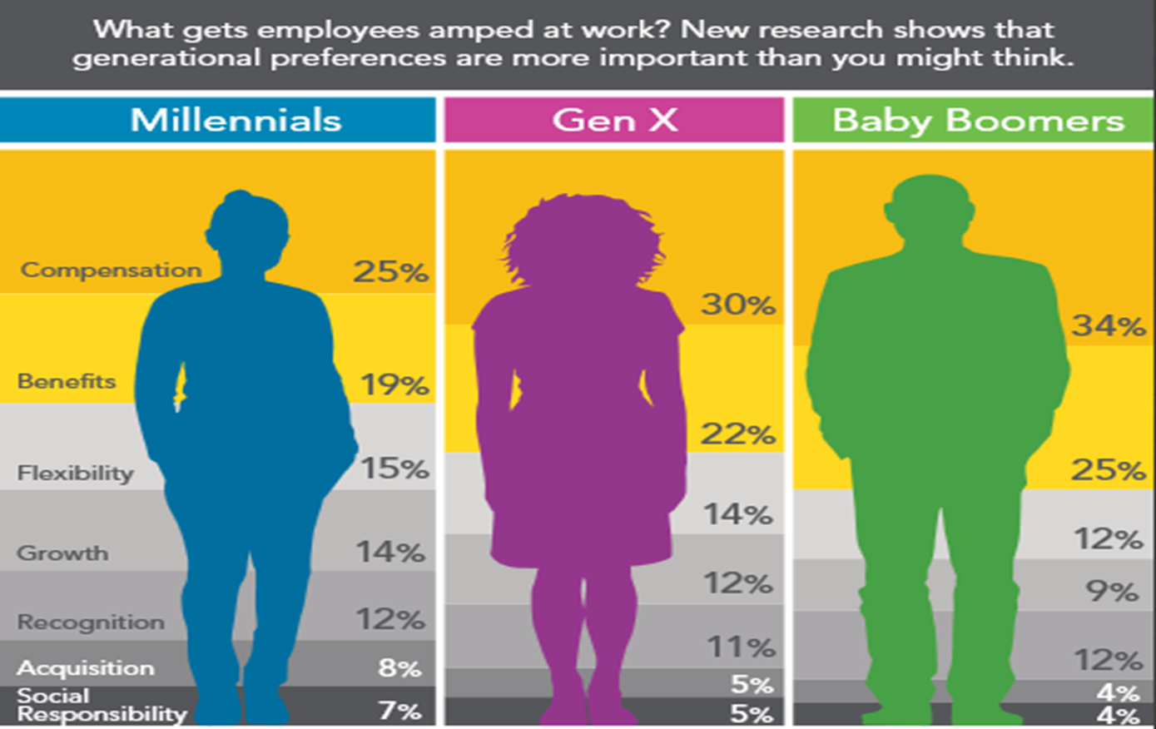
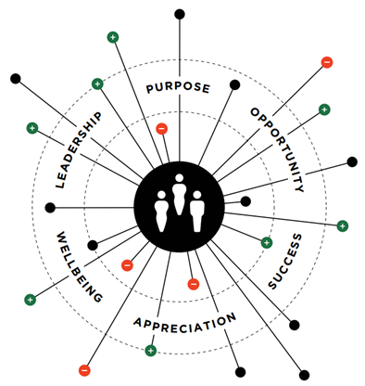
Generational Differences in the Workplace
RECRUIT, ENGAGE, RETAIN, REPEAT.
Notes:
It takes more than just pay and benefits to effectively attract, engage, and retain
6 TALENT MAGNETS:
Purpose: An organization’s reason for being besides profits. Employees need to feel connected to the purpose and understand how their job contributes to it
Opportunity: The chance to develop new skills, contribute to meaningful work, feel challenged, have a voice, and grow. These newer generations expect if not demand training.
Success: The thrill of accomplishment, innovation, breaking barriers.
Appreciation: Feeling valued for one’s contributions and being recognized for one’s worth.
Wellbeing: Caring about the employee as a whole-their physical, emotional, mental, and financial health.
Leadership: The mentoring, coaching, inspiring, and facilitating individuals, teams, and ultimately, the organization to succeed.
BABY BOOMERS make up 20% of your industry and with 10,000 boomers reaching the retirement age every day, that number is dwindling fast. Nevertheless, you still need to keep them engaged. Provide mentorship opportunities, communicate with them via phone calls and face to face interactions, tap into their experiences and ask them “What has worked best when you’ve tried to do this?”; offer them challenging projects that calls upon their vast wealth of experience and pay them well for that experience.
GENERATION X makes up 35.5% of your industry and possess something that technology cannot replace: hands on experience. As the bridge between boomers and millennials, they drive execution and bring new ideas to reality. They are looking for flexible schedules, more responsibility, and an open management style to encourage their creativity and ability to work independently.
MILLENNIALS make up 32.5% of your industry and is expected to make up 75% of the total workforce within the next 3 years. They want (no – no) they NEED feedback, recognition, a career path with growth potential, and flexible schedules with options for remote work. They are looking for purpose and ways to make their work feel meaningful. They feel the need to make a significant contribution to society. Leadership needs to be more coach-centric rather than a command and control style of management. Socialize with them often in and outside of work.
We all know the cost of doing business continues to rise. And what we pay our people is a part of that rising cost.

Slide 7
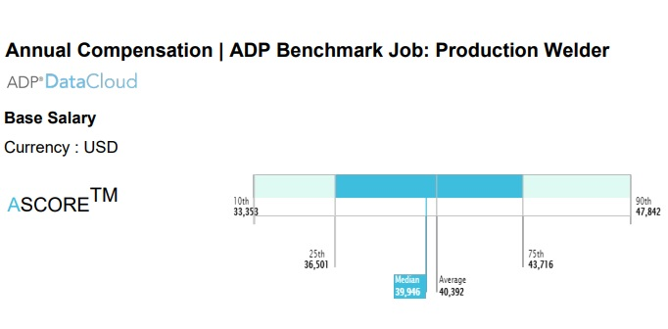
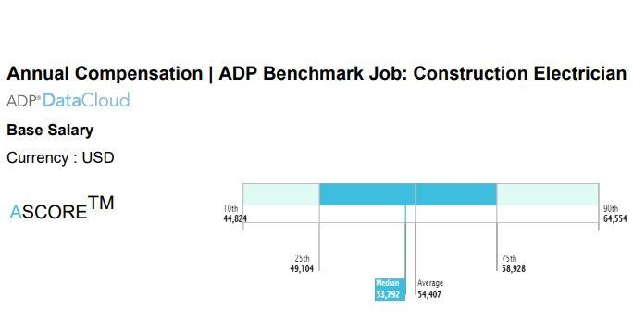
Generational Differences in the Workplace
COMPENSATION
Notes:
Wage growth in the U.S. has been incredibly slow over the last 30-plus years, but since the summer of 2020, wage growth has accelerated at a rapid pace, driven by competition. We’ve seen an increase in the minimum wage and businesses offering signing bonuses to try and attract top talent.
ADP’s senior vice president and chief economist said that in the decade leading up to the pandemic, wages never grew more than 3.5 percent from the previous year; however, compensation in October 2021 grew 4.9% year-over-year. How do we know this is accurate? ADP pays 1 in 6 U.S. workers which gives us access to real time pay data.
We know how important compensation is across all generations. Historically, businesses have used outdated studies and surveys to determine what to pay their people. In today’s market, that’s not realistic, so what ADP does is provide clients real time, anonymized data that they can use to make educated and informed decisions on your specific workforce.
This data is from a local company in the shipyard industry in VA Beach and it shows the benchmark information for compensation based on job position. You can see the job position of a Production Welder has an average base salary of $40,392 for this area and the position of an electrician has an average base salary of $54,407.
You can use this information to compare it to what you’re currently offering as a base salary and then add on those extras that resonate with the generation you’re targeting. For example, if you are targeting a boomer, maybe bump up that base salary number towards the 75th percentile. If you are targeting a millennial, we know that compensation makes up just 25% of what they care about, so start with that base salary but offer extras like benefits, a flexible work schedule, a clear career path with the opportunity for training and proving to them you will invest in their professional development and overall employee experience.
EMPLOYEE EXPERIENCE DRIVES OR DETERS BUSINESS OUTCOMES

Slide 8
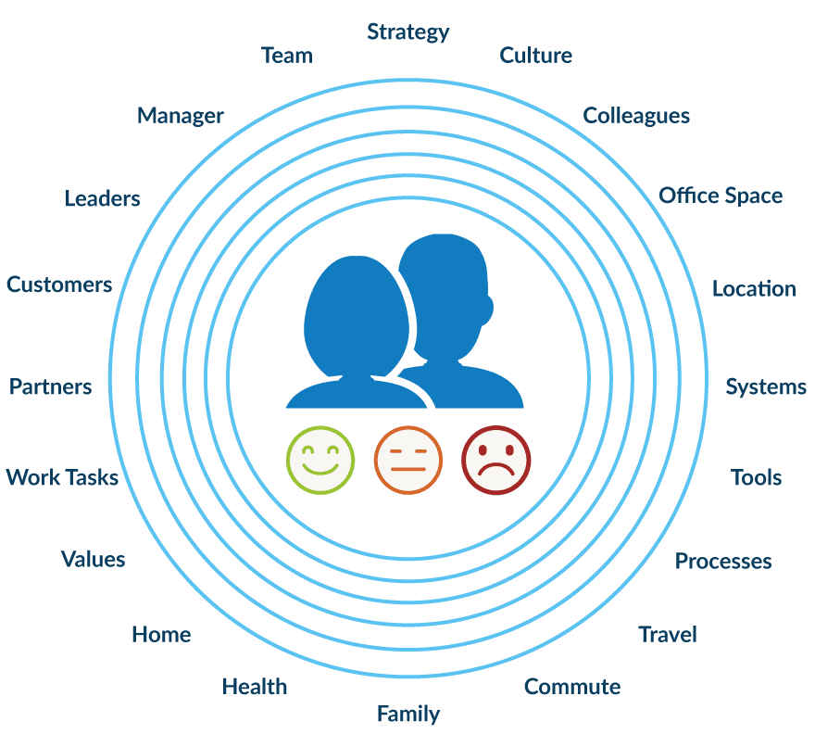
Generational Differences in the Workplace
EMPLOYEE EXPERIENCE
Notes:
The employee experience is so often overlooked and is the one secret weapon your organization can have to not only attract but retain your people.
In a difficult labor market, retention has become just as important if not more than important than recruitment efforts. We’ve all seen the headlines, “The Great Migration”, “The Great Resignation”, etc. Our data shows that employee experience is a leading indicator in an employee’s tenure.
You can google any study that supports happy and engaged employees lead to a more productive and profitable organization.
It is important to keep in mind what a good employee experience looks like to different generations:
On one end of the spectrum (Boomers & Gen X) you have employees who crave challenges, responsibility and the opportunity to mentor those younger generations. They prefer face to face interactions and hands on experience.
On the other end of the spectrum (Millennials & Gen Z) you have employees who are incredibly technology fluent and dependent, prefer team collaboration, a sense of purpose, and demand training and flexible work schedules.
So far, we’ve been focusing on how to better understand different generations from an employer perspective. Now let’s look at the employee perspective and how they perceive your organization.

Slide 9
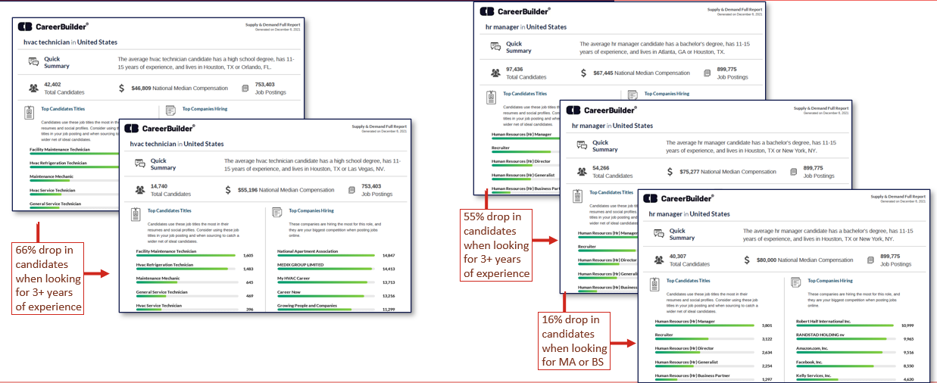
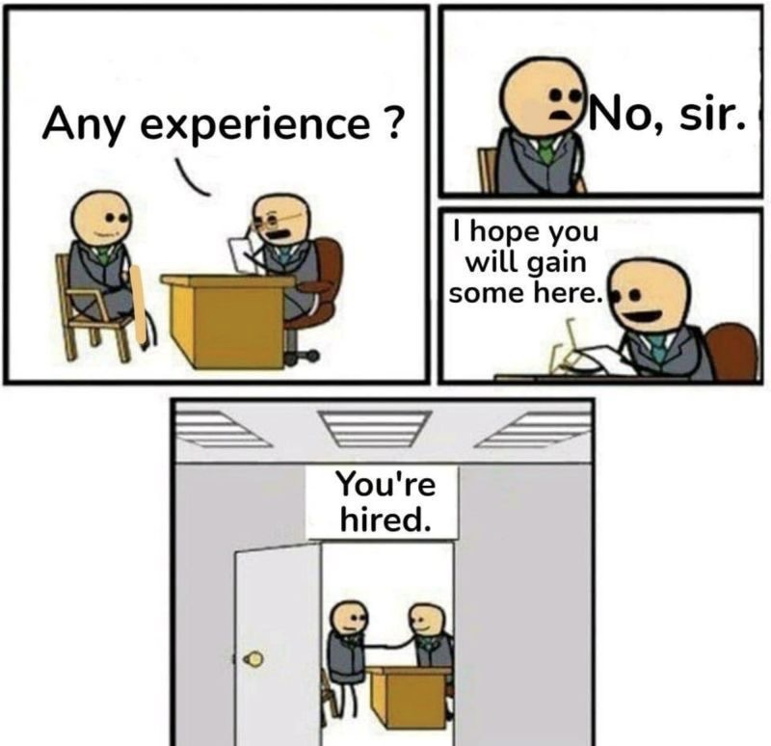
Generational Differences in the Workplace
You can’t buy the talent you need
Notes:
A job posting is often the first introduction of your company to a potential employee. You have to think about what matters to them. What’s the mission of your company (not tied to profit)? What training will you be providing? What is the potential career track? Are there mentor programs? Talk about culture.
We know the experience you all have in the shipyard industry is leaving and this newer generation is looking for flexibility, hands on training, purpose, etc. What we are finding are those organizations who continue to list required experience: 3+ years or a Bachelors degree are drastically reducing the number of candidates that are even looking at your posting by 66%, let alone applying for the job.
CEO Jeff Berger of Talent Inc (global leader in technology-enabled career services) conducted a survey on what factor was the most important in a candidate between education, experience, potential, and personality. Anyone wanna throw a guess as to what was ranked as the most important?
Potential 45%, experience 37%, personality and education coming in last.
EXPERIENCE is important and weighted more heavily than EDUCATION
But an EE’s POTENTIAL combined with what an employer can invest in and develop with the proper training carries more weight than EXPERIENCE
The makeup of the workforce has taken a tremendous shift and will continue to for the next 15 years. You can no longer buy the talent you need. You need to invest in and develop the talent.
To wrap things up:

Slide 10
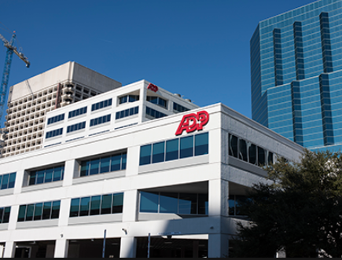
Generational Differences in the Workplace
April Jernigan
District Manager
Norfolk, VA
(757) 810-7969
April.Jernigan@adp.com
Thank you!
ADP Norfolk
Notes:
Every generation in the workforce is different and they are looking for something different from their employers.
A business’s brand is ultimately what attracts the best people, but how you manage them once they come onboard will determine how long you keep those people. This is a challenge that HR professionals will continue to face and they will need constant support, insight, and data to be able to adapt to these changing external factors.
I hope you found this information helpful, insightful, and hopefully you’re walking away with ideas to implement at your organization. And if anyone wants to chat offline, please jot my information down and connect with me later.
THANK YOU.

