Slide 1
LEGISLATIVE UPDATE
Presented by
Christopher Abel
Willcox & Savage, P.C.
VSRA HR SEMINAR
April 6, 2018

Slide 2
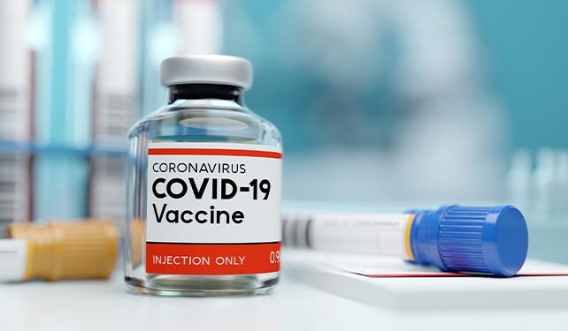
Notes:
2

Slide 3
VIRGINIA LAW
STATE MINIMUM WAGE
January 1, 2022
$11.00/Hour
Notes:
3

Slide 4
VIRGINIA LAW
E.O. 6
EMERGENCY TEMPORARY STANDARD
Notes:
4

Slide 5
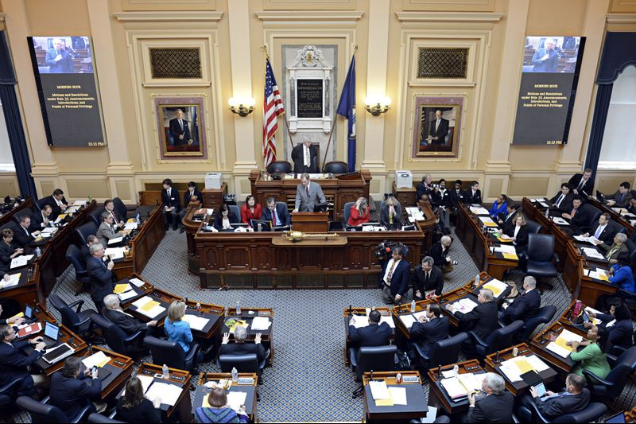
VIRGINIA LAW
Notes:
5

Slide 6
VIRGINIA LAW
HB 1040
STATE MINIMUM WAGE
Notes:
6

Slide 7
VIRGINIA LAW
SB 447
WAGE AND SALARY HISTORY &
RANGE FOR JOB
Notes:
7

Slide 8
VIRGINIA LAW
HB 1173/SB 631
VIRGINIA OVERTIME WAGE ACT
FLSA
Notes:
8

Slide 9
FEDERAL LAW
CROWN ACT
Notes:
9

Slide 10
FEDERAL LAW
E.O. 13658
$11.25
Existing Contracts
E.O. 14026
$15.00
New After January 30, 2022
Notes:
10

Slide 11
FEDERAL LAW
PREGNANT WORKERS FAIRNESS ACT
Notes:
11

Slide 12
2020
Notes:
12

Slide 13
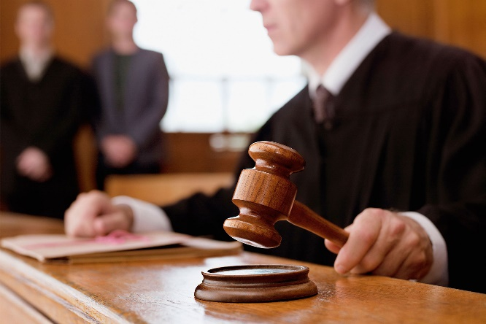
VIRGINIA LAW
VIRGINIA HUMAN RIGHTS ACT
EMPLOYEE MISCLASSIFICATION STATUTE
WAGE PAYMENT STATUTE
Notes:
13

Slide 14
VIRGINIA LAW
WHISTLEBLOWER PROTECTION ACT
EMPLOYEE RECORDS DISCLOSURE ACT
Notes:
14

Slide 15
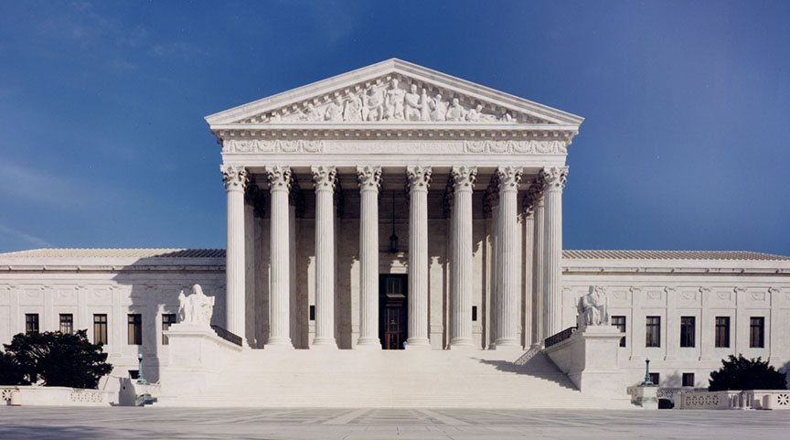
FEDERAL LAW
BOSTOCK v. CLAYTON COUNTY
Notes:
15

Slide 16
HUMAN RESOURCES COMMITTEE
Notes:
16

Slide 17
Chris Abel Willcox & Savage, P.C. 440 Monticello Avenue, Suite 2200 Norfolk, VA 23510-2243 757-628-5500 www.willcoxsavage.com

