Slide 1
Working towards Visible Equity
Prepared and presented by
Dr. Veleka S. Gatling, Interim AVP Equity and Diversity
Office of Institutional Equity and Diversity

Slide 2
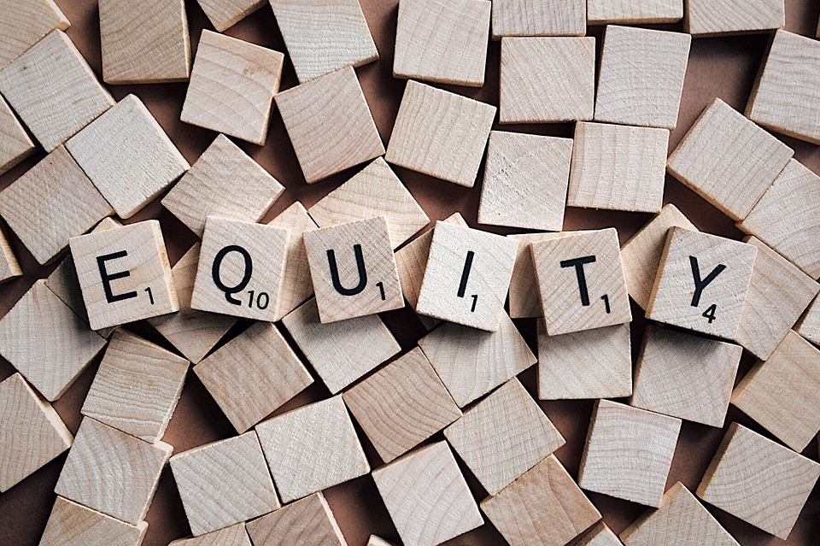
Visible Equity is about ensuring that your own self-reflection and self-awareness plays a vital role in shaping philosophy, policies, and practices resulting in ongoing opportunities for marginalized and
under-represented populations to thrive and grow.
- Dr. Veleka S . Gatling

Slide 3
To achieve “visible equity,” we must humanize members within our communities of practice in ways that respect, and acceptance become the norm, not just another cliché. Then, we must demonstrate respect by seeking to understand others and treating them as they desire, not as we desire. We must listen to others’ stories and begin shifting our cultural perspectives to achieve acceptance and adaptation, thus operationalizing what it means to be inclusive.

Slide 5
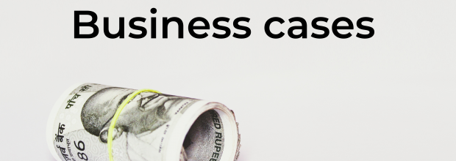
Diversity without inclusion is not enough. Organizations with inclusive cultures are:
2x as likely to meet or exceed financial targets
3x as likely to be high performing
6x more likely to be innovative and agile
8x more likely to achieve better business outcomes
(Deloitte Review 2018)
74% of millennials believe their organization is more innovative when it has a culture of inclusion. If businesses are looking to hire and sustain a millennial workforce, diversity must be a key part of the company culture. (2018 Deloitte Millennial Survey)
Notes:
Why the maritime industry needs to improve diversity in the workplace
(The Global Maritime Forum)

Slide 6
OBJECTIVES
1
Importance of Self-Reflection and Self Awareness
2
Importance of being aware of conscious and unconscious bias in decision making
3
Importance of creating conditions for “better conversations”
Importance of building your capacity because this is a MOVEMENT NOT A MOMENT, A JOURNEY AND NOT A JOLT
4

Slide 7
Be…
Open
Authentic
Engaged
Comfortable with being uncomfortable
Non-Judgmental
Understanding

Slide 8
What makes me, me?
Part 1. Personal Reflection – 3 mins.
What characteristics or experiences have most influenced the way that you see the world?
Part 2. Sharing – 20 minutes
Each person shares their reflection with the others, within no more than 2 minutes.
Keep time.
Do not interrupt or discuss.
Listen to understand; avoid creating a parallel or comparative narrative.
After each member of the group has shared their reflection, discuss what you learned from each other.

Slide 9
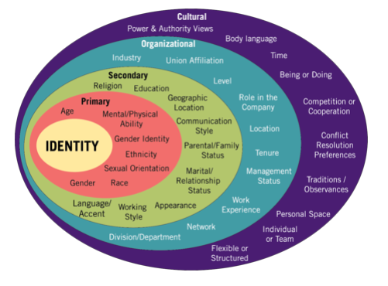
Notes:
https://www.dayzim.com/news/understanding-dei-a-closer-look-at-diversity
Day and Zimmerman

Slide 11
Unconscious Bias (also known as Implicit Bias)
Attitudes or stereotypes that affect our understanding, action and decisions in an unconscious manner
Blind spots
Unconscious bias require personal motivation and dedicated effort to unlearn
Paying attention to the possibility for unconscious bias (self-awareness)allows us to consider how we engage or disengage with others.
Bias does not automatically equate to being anti _______.
It is possible to hold bias against a group with which you identify
It is possible for men and women to hold implicit gender bias or to have preferences for those outside of their own race, ethnicity, etc.

Slide 12
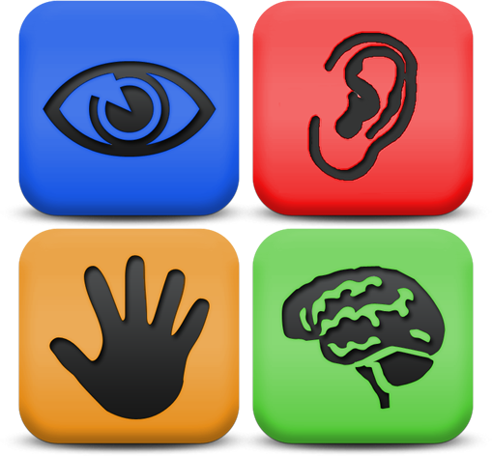
We see, hear and feel what we believe…
Everyone experiences the world slightly different based on your lived and learned experiences
It is not wrong or right
It’s human nature
How we see the world is based on our culture and our identity

Slide 13
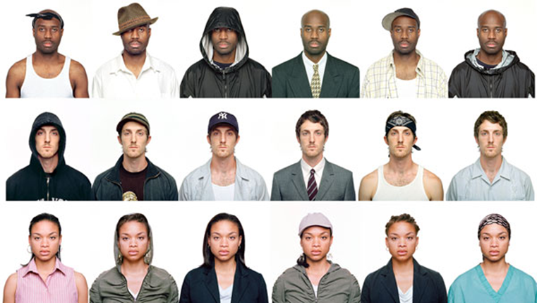
Our Kind of People, Beyete Ross Smith
http://www.bayeterosssmith.com/our-kind-of-people

Slide 14
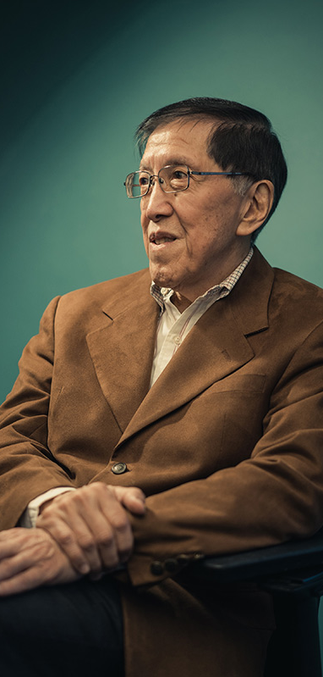
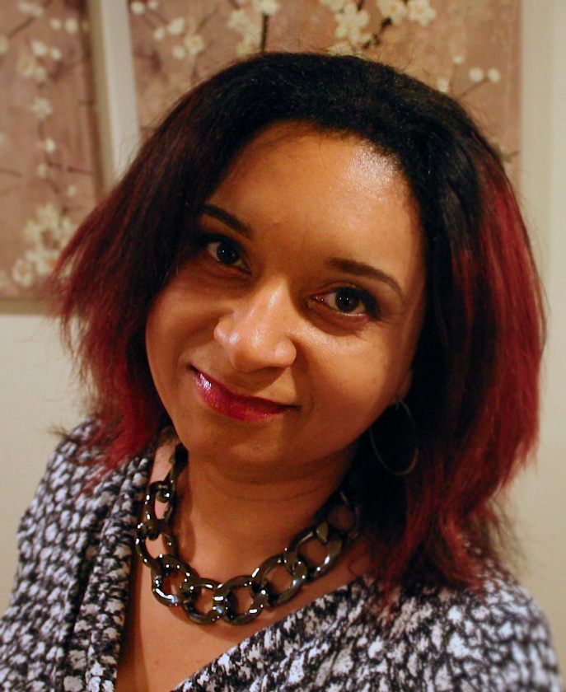
Dr. Derald Wing Sue
Microaggressions
Words or actions
Brief and commonplace; often daily
Intentional or unintentional
Often framed as “humor” or a “compliment”
Felt as Indignities and insults
Have a cumulative impact
Dr. Chester M. Pierce
Dr. Monnica T. Williams

Slide 15
What has been your experience(s) with microaggressions?

Slide 16
EXAMPLES OF MICRO-SUPPORT
Acknowledge contributions
Break the silence
Hold each other accountable when microaggressions are observed
Provide full attention
Recognize strengths
Respectfully ask questions for clarification
Do your research
Notes:
Actions that minimize microaggressions and advance a more inclusive workplace include:
Acknowledging the contributions of others
Breaking the silence
Holding each other accountable when microaggressions occur.
Providing our full attention
Recognizing strengths in others ---and
Respectfully asking questions for clarification.

Slide 17
```
EXERCISE
In your group, someone begins the conversation:
“Let’s plan a company retreat to Bermuda
That short phrase is then handed off another person to build on the first statement:
“Yes, but…” add another short idea, then hand off to another.
“Yes, but…”
Keep going until time is called.

Slide 18
In your group, someone begins the conversation:
“Let’s plan a company retreat to the Bermuda.”
That short phrase is then handed off another person to build on the first statement:
“Yes, AND…” add another short idea, then hand off to another.
“Yes, but…”
Keep going until time is called.
TRY AGAIN

Slide 19
WHAT DOES“YES, BUT” MEAN?
-Negates what precedes the but
-Crushes new ideas
-Impedes understanding

Slide 20
Affirmation

Slide 21
DNA Model
Describe
Describe before interpreting-- no judgement
Navigate
Navigate your interpretations- how you your feel about the interaction
Adapt
Adapt your behavior based on your interpretation
Mary Francis-Winters, 2017

Slide 22
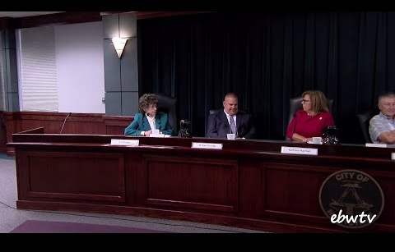

Slide 23
How do I lead by example, when I don’t know
what I don’t
know about _____?
Exposure
Experience
Education
Empathy
Mary Francis-Winters, 2017

Slide 24
Brené Brown – Dare to Lead
Notes:
https://www.youtube.com/results?search_query=brene+brown+and+jimmy+fallon

Slide 26
