Slide 1
VSRA 25th Annual Safety & Health Seminar
Kevin Terry
Vice-Chairman of VSRA BOD
General Manager
NASSCO-Norfolk
29 September 2021

Slide 2
Opening Comments
Theme of this Seminar: Staying Alive, Another 25!
Where were you on September 29th, 1996?
Happenings in September, 1996
Nintendo 64 video game systems rolls out in United States
Major League Soccer (MLS) is formed
Rapper and Actor, Tupac Shakur (age 25), dies after a drive by shooting
Space Shuttle, Atlantis 17, launches into space
Reality show “Judge Judy” premieres
President Bill Clinton signed the UN Comprehensive Nuclear Test Ban Treaty
“George” magazine publisher John F. Kennedy Jr. marries Caroline Bessette
Mad Cow Disease hit the United Kingdom
Notes:
Welcome, Theme of Conference

Slide 3
Opening Comments
Do you know someone who was injured recently?
This week
This month
This year
Do you know someone who has died recently?
This week
This month
This year
Fatal Occupational Job-related homicides in 1996 was 6,112
Fatal Occupational Job-related homicides in 2019 was 5,333
Notes:
My career experiences, similar to the Ohio State films of “Scared Straight” for driver training
Sailors on Nimitz, red tag violation, steam burns; 3 NNS fatalities with toxic gas, red tag violation, Arm amputee with fork lift operator, Employee biking home from work, hit by bus, Fatality earlier this year on McFaul with Subcontractor

Slide 4
Top 10 Most Frequently OSHA Violations (FY2020)
Fall Protection, construction
Hazard Communication Standard, general industry
Respiratory Protection, general industry
Scaffolding, general requirements, construction
Ladders, construction
Control of Hazardous Energy (lockout/tagout), general industry
Powered Industrial Trucks, general industry
Fall Protection–Training Requirements
Eye and Face Protection
Machinery and Machine Guarding, general requirements

Slide 5
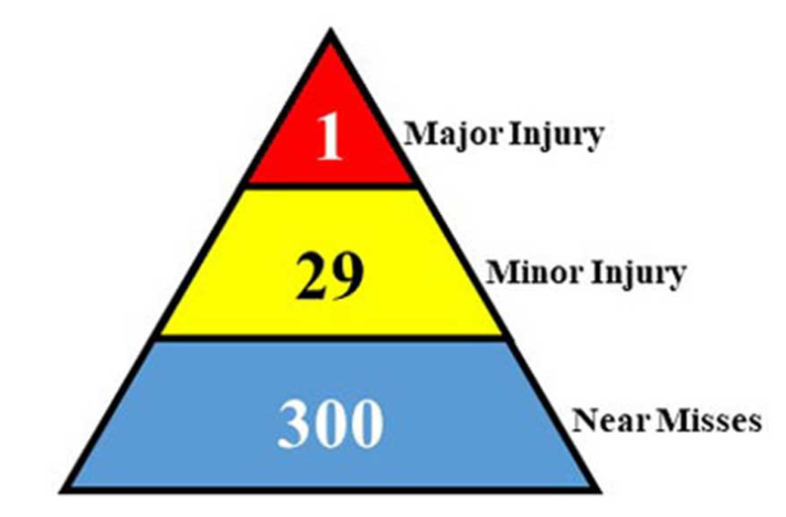
Safety Goals
Kindley’s Triangle
Safety Triangle by Herbert Heinrich (~1930s)
Notes:
NASSCO’s safety goal, Kindley’s triangle
One Injury too much, Signal messaging about family

Slide 6
Staying Alive because………………?
Everyone here better be able to answer that question!
Family, Life, Purpose, Legacy
Home Early 2012-2013 TVC 90 sec – YouTube

Slide 7
The Dash
What is a dash?
The Dash Poem - Live Your Dash - The Dash Movie – YouTube

Slide 8
Be Safe! Another 25!

